Slide 1
Web Technologies
CLIENT SIDE ESSENTIALS
Java Script Objects and Functions – JQuery – Accessing DOM Elements using Java Script
and JQuery Objects – Java Script Event Handling – XML DOM – AJAX Enabled Rich
Internet Applications with XML and JSON – Dynamic Access and Manipulation of Web
Pages using Java Script and JQuery – Web Speech API – Speech Synthesis Markup
Language.

Slide 2
XML DOM
DOM - Document Object Model. It defines a standard way to access and manipulate documents.
The Document Object Model (DOM) is a programming API for HTML and XML documents.
It defines the logical structure of documents and the way a document is accessed and manipulated.
As a W3C specification, one important objective is to provide a standard programming interface that can be used in a wide variety of environments and applications. The Document Object Model can be used with any programming language.
XML DOM defines a standard way to access and manipulate XML documents.
XML documents have a hierarchy of informational units called nodes; DOM is a way of describing those nodes and the relationships between them.
A DOM document is a collection of nodes or pieces of information organized in a hierarchy.
This hierarchy allows a developer to navigate through the tree looking for specific information. Because it is based on a hierarchy of information, the DOM is said to be tree based.
The XML DOM, on the other hand, also provides an API that allows a developer to add, edit, move, or remove nodes in the tree at any point in order to create an application.
Features of DOM Parser
A DOM Parser creates an internal structure in memory which is a DOM document object and the client applications get information of the original XML document by invoking methods on this document object.
DOM Parser has a tree based structure.

Slide 3
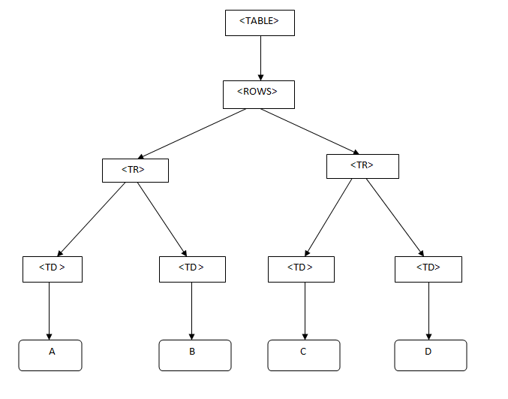
XML DOM
Document Object Model represent XML like this:
<TABLE>
<ROWS>
<TR>
<TD>A</TD>
<TD>B</TD>
</TR>
<TR>
<TD>C</TD>
<TD>D</TD>
</TR>
</ROWS>
</TABLE>

Slide 4
XML DOM
<!DOCTYPE html>
<html> <body>
<h1>Welcome Note</h1>
<div>
<b>To:</b> <span id="to"></span><br>
<b>From:</b> <span id="from"></span><br>
<b>Message:</b> <span id="message"></span>
</div>
<script>
txt1="<note>";
txt2="<to>Office IT</to>";
txt3="<from>ABC</from>";
txt4="<body>Welcome to IT dept</body>";
txt5="</note>";
txt=txt1+txt2+txt3+txt4+txt5;
if (window.DOMParser) {
parser=new DOMParser();
xmlDoc=parser.parseFromString(txt,"text/xml"); }
else // Internet Explorer {
xmlDoc=new ActiveXObject("Microsoft.XMLDOM");
xmlDoc.async=false;
xmlDoc.loadXML(txt); }
document.getElementById("to").innerHTML=
xmlDoc.getElementsByTagName("to")[0].childNodes[0].nodeValue;
document.getElementById("from").innerHTML=
xmlDoc.getElementsByTagName("from")[0].childNodes[0].nodeValue;
document.getElementById("message").innerHTML=
xmlDoc.getElementsByTagName("body")[0].childNodes[0].nodeValue;
</script> </body> </html>
XML DOM - Load XML String
parses an XML string into an XML DOM object and then extracts some information from it with a JavaScript.
HTML file that extracts the data of XML string using DOM.
DOMParser interface provides the ability to parse XML or HTML source code from a string into a DOM Document.
DOMParser() constructor →creates a new DOMParser object.
Return value
DOMParser object→can be used to parse the text of a document using the parseFromString() method.
DOMParser.parseFromString()
Parses a string using either the HTML parser or the XML parser, returning an HTMLDocument or XMLDocument.

Slide 5
XML DOM
<!DOCTYPE html>
<html> <body>
<h1>Welcome Note</h1>
<div>
<b>To:</b> <span id="to"></span><br>
<b>From:</b> <span id="from"></span><br>
<b>Message:</b> <span id="message"></span>
</div>
<script>
txt1="<note>";
txt2="<to>Office IT</to>";
txt3="<from>ABC</from>";
txt4="<body>Welcome to IT dept</body>";
txt5="</note>";
txt=txt1+txt2+txt3+txt4+txt5;
if (window.DOMParser) {
parser=new DOMParser();
xmlDoc=parser.parseFromString(txt,"text/xml"); }
else // Internet Explorer {
xmlDoc=new ActiveXObject("Microsoft.XMLDOM");
xmlDoc.async=false;
xmlDoc.loadXML(txt); }
document.getElementById("to").innerHTML=
xmlDoc.getElementsByTagName("to")[0].childNodes[0].nodeValue;
document.getElementById("from").innerHTML=
xmlDoc.getElementsByTagName("from")[0].childNodes[0].nodeValue;
document.getElementById("message").innerHTML=
xmlDoc.getElementsByTagName("body")[0].childNodes[0].nodeValue;
</script> </body> </html>
DOMParser.parseFromString()
Parameters
String→The DOMString to be parsed. It must contain either an HTML, xml, xhtml+xml, or svg document.
mimeType→A DOMString. This string determines whether the XML parser or the HTML parser is used to parse the string. Valid values are:text/html, text/xml
A value of text/html will invoke the HTML parser, and the method will return an HTMLDocument.
Text/xml→invoke the XML parser, and the method will return a XMLDocument.
ActiveXObject("Microsoft.XMLDOM")→creates an empty Microsoft XML document object.
xmlDoc.async="false“→turns off asynchronized loading, to make sure that the parser will not continue execution of the script before the document is fully loaded.
xmlDoc.loadXML(txt)→used for loading strings (text), load() is used for loading files.

Slide 6
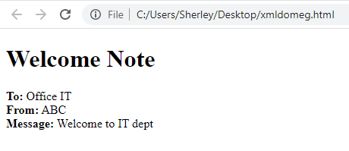
XML DOM
<!DOCTYPE html>
<html> <body>
<h1>Welcome Note</h1>
<div>
<b>To:</b> <span id="to"></span><br>
<b>From:</b> <span id="from"></span><br>
<b>Message:</b> <span id="message"></span>
</div>
<script>
txt1="<note>";
txt2="<to>Office IT</to>";
txt3="<from>ABC</from>";
txt4="<body>Welcome to IT dept</body>";
txt5="</note>";
txt=txt1+txt2+txt3+txt4+txt5;
if (window.DOMParser) {
parser=new DOMParser();
xmlDoc=parser.parseFromString(txt,"text/xml"); }
else // Internet Explorer {
xmlDoc=new ActiveXObject("Microsoft.XMLDOM");
xmlDoc.async=false;
xmlDoc.loadXML(txt); }
document.getElementById("to").innerHTML=
xmlDoc.getElementsByTagName("to")[0].childNodes[0].nodeValue;
document.getElementById("from").innerHTML=
xmlDoc.getElementsByTagName("from")[0].childNodes[0].nodeValue;
document.getElementById("message").innerHTML=
xmlDoc.getElementsByTagName("body")[0].childNodes[0].nodeValue;
</script> </body> </html>
getElementsByTagName() method returns a node list of all elements, with the specified tag name, in the same order as they appear in the source document.
childNodes property returns a list of an element's child nodes.
nodeValue property returns the text value of a text node.

Slide 7
XML DOM
<!DOCTYPE html>
<html> <body>
<h1>Important Note</h1>
<div>
<b>To:</b> <span id="to"></span><br>
<b>From:</b> <span id="from"></span><br>
<b>Message:</b> <span id="message"></span>
</div>
<script>
if (window.XMLHttpRequest)
{// code for IE7+, Firefox, Chrome, Opera, Safari
xmlhttp=new XMLHttpRequest();
}
else
{// code for IE6, IE5
xmlhttp=new ActiveXObject("Microsoft.XMLHTTP");
}
xmlhttp.open("GET","note.xml",false);
xmlhttp.send();
xmlDoc=xmlhttp.responseXML;
document.getElementById("to").innerHTML=
xmlDoc.getElementsByTagName("to")[0].childNodes[0].nodeValue;
document.getElementById("from").innerHTML=
xmlDoc.getElementsByTagName("from")[0].childNodes[0].nodeValue;
document.getElementById("message").innerHTML=
xmlDoc.getElementsByTagName("body")[0].childNodes[0].nodeValue;
</script>
</body> </html>
//note.xml
<?xml version="1.0" encoding="ISO-8859-1"?>
<note>
<to>officeit@gmail.com</to>
<from>abc@gmail.com</from>
<body>Hello from XML DOM</body>
</note>
XMLHttpRequest→ to issue HTTP requests in order to exchange data between the web site and a server.
Steps:
To send an HTTP request, create an XMLHttpRequest object
open a URL
XMLHttpRequest can fetch the data in one of two ways, asynchronously or synchronously.
The type of request is dictated by the optional async argument (the third argument) that is set on the XMLHttpRequest.open() method.
If this argument is true or not specified, the XMLHttpRequest is processed asynchronously, otherwise the process is handled synchronously
send the GET request. –send()
After the transaction completes, the object will contain useful information such as the response body and the HTTP status of the result.

Slide 8
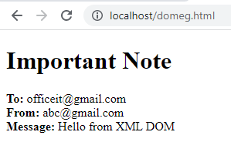
XML DOM
<!DOCTYPE html>
<html> <body>
<h1>Important Note</h1>
<div>
<b>To:</b> <span id="to"></span><br>
<b>From:</b> <span id="from"></span><br>
<b>Message:</b> <span id="message"></span>
</div>
<script>
if (window.XMLHttpRequest)
{// code for IE7+, Firefox, Chrome, Opera, Safari
xmlhttp=new XMLHttpRequest();
}
else
{// code for IE6, IE5
xmlhttp=new ActiveXObject("Microsoft.XMLHTTP");
}
xmlhttp.open("GET","note.xml",false);
xmlhttp.send();
xmlDoc=xmlhttp.responseXML;
document.getElementById("to").innerHTML=
xmlDoc.getElementsByTagName("to")[0].childNodes[0].nodeValue;
document.getElementById("from").innerHTML=
xmlDoc.getElementsByTagName("from")[0].childNodes[0].nodeValue;
document.getElementById("message").innerHTML=
xmlDoc.getElementsByTagName("body")[0].childNodes[0].nodeValue;
</script>
</body> </html>
XMLHttpRequest() constructor→ These tell the client making the XMLHttpRequest important information about the status of the response.
XMLHttpRequest.responseXML read-only property returns a Document containing the HTML or XML retrieved by the request; or null if the request was unsuccessful, has not yet been sent, or if the data can't be parsed as XML or HTML.
XMLHttpRequest.status property returns the numerical HTTP status code of the XMLHttpRequest's response.
Status: 200-OK
404-page not found

Slide 9
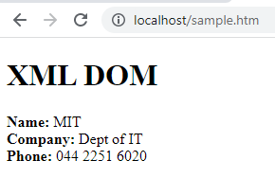
XML DOM
//address.xml
<?xml version = "1.0"?>
<contact-info>
<name>MIT</name>
<company>Dept of IT</company>
<phone>044 2251 6020</phone>
</contact-info>
<!DOCTYPE html>
<html>
<body>
<h1>XML DOM </h1><div>
<b>Name:</b> <span id = "name"></span><br>
<b>Company:</b> <span id = "company"></span><br>
<b>Phone:</b> <span id = "phone"></span>
</div>
<script>
if (window.XMLHttpRequest)
{// code for IE7+, Firefox, Chrome, Opera, Safari
xmlhttp = new XMLHttpRequest();
}
else
{// code for IE6, IE5
xmlhttp = new ActiveXObject("Microsoft.XMLHTTP"); }
xmlhttp.open("GET","address.xml",false);
xmlhttp.send();
xmlDoc = xmlhttp.responseXML;
document.getElementById("name").innerHTML=
xmlDoc.getElementsByTagName("name")[0].childNodes[0].nodeValue;
document.getElementById("company").innerHTML=
xmlDoc.getElementsByTagName("company")[0].childNodes[0].nodeValue;
document.getElementById("phone").innerHTML=
xmlDoc.getElementsByTagName("phone")[0].childNodes[0].nodeValue;
</script></body></html>

